Slide 1

The Legacy of Mary Mallon
Kirsten McNurlin, RN, BSN, CIC
APIC MT Fall Retreat
Hamilton, MT
08 October 2022

Slide 2
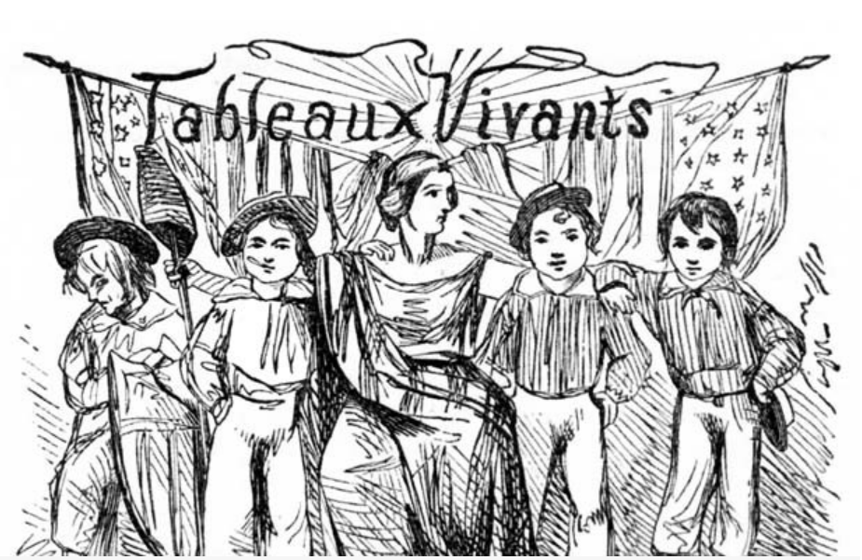
Set the Scene Via Tableau Vivant
Tableau vivant is French for ‘living picture’. It’s a depiction of a scene usually presented on a stage by participants.
Popular form of entertainment among middle and upper classes in the 19th Century.
Group participants will be asked to assume the roles of significant people in Mary Mallon’s life (bacteriologists, public policy makers, lawyers, newspaper journalists, families, and society members). Don’t worry, ‘the script’ has been provided for you.

Slide 3
Set the Time - End of the 19th Century
Germ Theory: microorganisms, not filth/contaminated air, caused disease.
Typhoid fever was one of the 19th century’s worst killers.
It abated somewhat with urban sanitation measures; however, it remained a public health problem.
Bacteriological studies discovered that typhoid could be transmitted by healthy people.

Slide 4
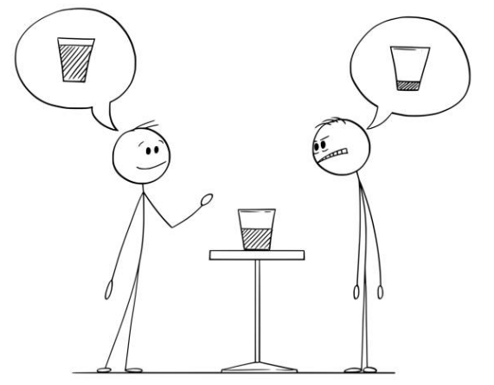
One Story … Ten Perspectives
There are various ways to tell Mary Mallon’s story. While they all differ, they are all relevant.
Some interpretations align alongside one another. Others are in significant conflict.
Engage in the process of interpretation and find your own meaning in this story.

Slide 5
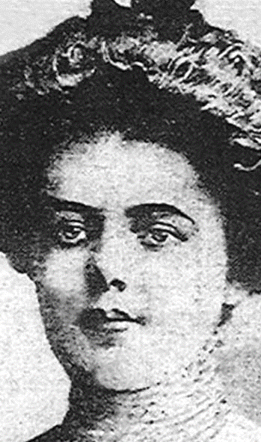
Mary Mallon – Cook
Biography
Perspective: ‘I have resented my incarceration from the beginning. The health inspector literally dragged me into the city ambulance. I’ve never had typhoid in my life and have always been healthy. Why should I be banished like a leper and compelled to live in solitary confinement with only a dog for a companion?’

Slide 6
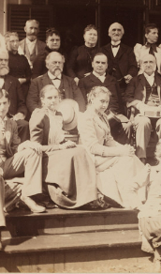
Walter Bowen Family
Biography:
Perspective: ‘Our family hired Ms. Mallon during the winter of 1906-1907. Ms. Mallon was apprehended in my Park Avenue home by George Soper. It was surprising and dramatic. Two months after her initial employment, a chambermaid in the household became ill with typhoid fever. Soon afterwards, our daughter became ill and died.’

Slide 7
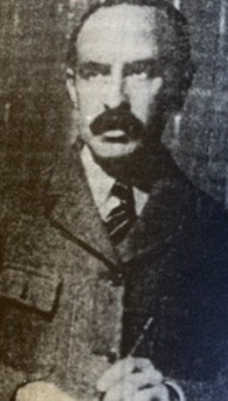
George Soper Ph.D – Investigator
Biography:
Perspective: ‘By tracing Mary Mallon’s job history and tracking down cases and patterns, I was convinced that Mary Mallon was the common link. I knew my epidemiological conclusions had to be thorough and supported by laboratory proof. As an independent investigator, I did not have authority to demand Mary’s compliance with supplying lab samples. I presented my evidence to Hermann Biggs, Medical Officer/NYC DOH, so he could pursue the case.’

Slide 8
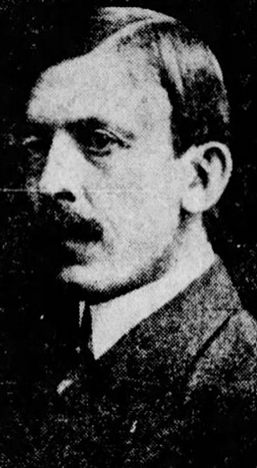
Hermann Biggs – Medical Officer of the NYC DOH
Biography
Perspective: ‘I built my perspective on science. Because of this new science, it is possible that individuals, although asymptomatic, put the general public at risk for disease. It was necessary to isolate Mary for 26 years because she was responsible for 3 deaths and at least 47 cases of typhoid fever. Ms. Mallon’s case is clear cut. It is necessary to infringe on an individual’s rights in order to protect the public. Mary is a cog in a machine much larger than herself.’

Slide 9
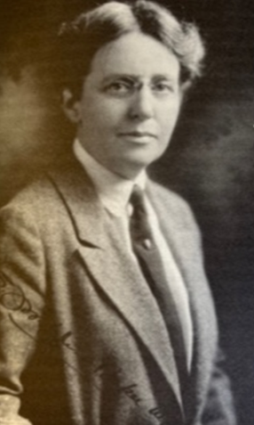
Dr. Josephine Baker – NYC Health Inspector
Biography:
Perspective: ‘When it was clear I could not reason with Mary, she left me know other option than to call the police to put her in the ambulance. I literally sat on her all the way to Willard Parker Hospital : it was like being in a cage with an angry lion.’

Slide 10

George Francis O’Neill – Attorney
Biography
Perspective/Standpoint: ‘Mary Mallon has never been sick with typhoid is not a menace to the health of society. Mary was arrested without proper warrants for due process. I ask, ‘does the health department have a legal right to banish a healthy person to lifetime isolation?’’

Slide 11
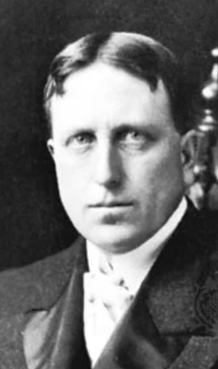
William Randolph Hearst- Newspaper Publisher
Biography:
Perspectives: ‘Call me a drama queen, but I must emphasize the personal misfortune of Ms. Mallon who was forced to give up a productive life to languish on an island.’
‘I am willing to pay Mary’s legal fees so I can get the story for my newspaper’.
‘What? Mary Mallon has returned to cooking even after promising she would not? She’s a dreaded demon, a carrier of sickness and death. She is a fiend, dropping human skulls into a skillet.’.

Slide 12
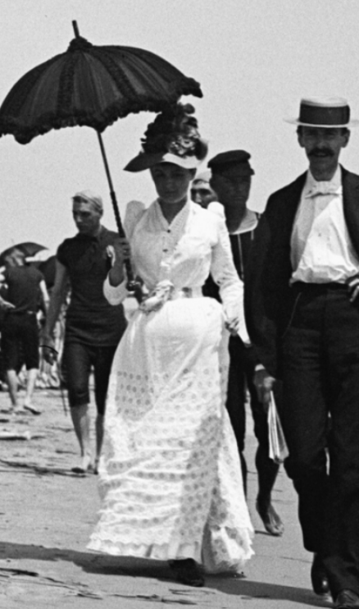
New York 19th Century Society
Biography:
Perspective: ‘Mary got what she deserved. She is culpable for her actions, and she acted from free will. She was a lower-class immigrant and did not measure up to middle class behavior. She was expendable in the fight to protect the public health of all New Yorkers. The microbe was not at fault, its carrier was.’

Slide 13
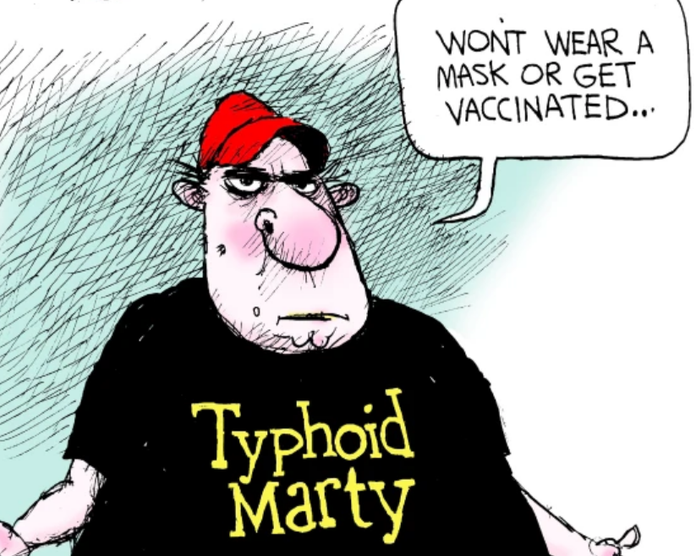
New York City 21st Century Society
Biography:
Perspective: ‘I may not have any knowledge of Mary Mallon as a person, but I think of ‘Typhoid Mary’ as a plague carrier, a metaphor for contamination.’

Slide 14
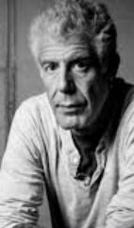
Anthony Bourdain – Chef and Author
Biography
Perspective: ‘I’m a chef, and what interests me about Mary Mallon is that she was a proud cook. Ms. Mallon found herself utterly screwed by forces she neither understood nor had the ability to control. I see Mary as a tormented loner, a woman in a male world, in hostile territory, frequently on the run.’

Slide 15
10 Perspectives – What is Yours?

Slide 16
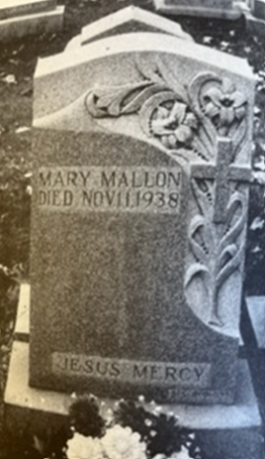
Closing / References
‘I lived a decent upright life under the name of Mary Mallon until I was seized … locked up in a pest-house and rechristened ‘Typhoid Mary.’’
- Mary Mallon

